Slide 1
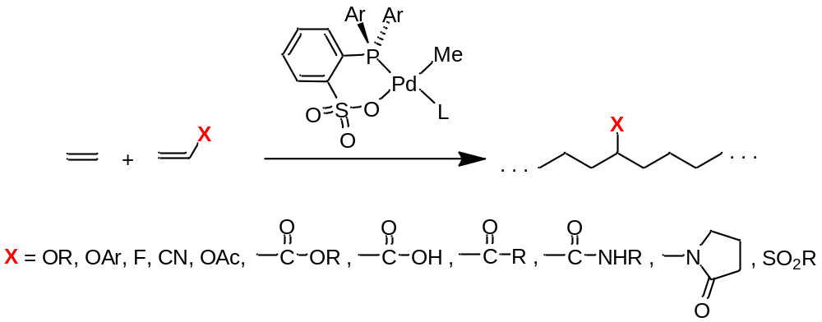
Pugh & Drent Chem. Comm. 2002,744; Jordan JACS 2007, 129, 8946;
Jordan JACS 2007, 129, 15450; Nozaki JACS 2007, 129, 8948;
Nozaki JACS 2009, 131, 14606; Mecking JACS 2009, 131, 422;
Mecking JACS 2010, 132, 17690; Sen OM 2008, 27, 3331;
Claverie Macromol. 2008, 41, 2309; Mecking Macromol. 2010, 43, 3589.
Notes:
Drent: Acylate.
Jordan: 8946 vinyl ether; 15450 vinyl fluoride
Nozaki: 8948 acrylonitrile; 14606 vinyl acetate
Mecking: 422 acrylate; 17690 acrylic acid; 3589 sulfone.
Sen: methyl vinyl ketone;
Claverie: 2309 acrylamide, N-Vinyl-2-pyrrolidinone.

Slide 2
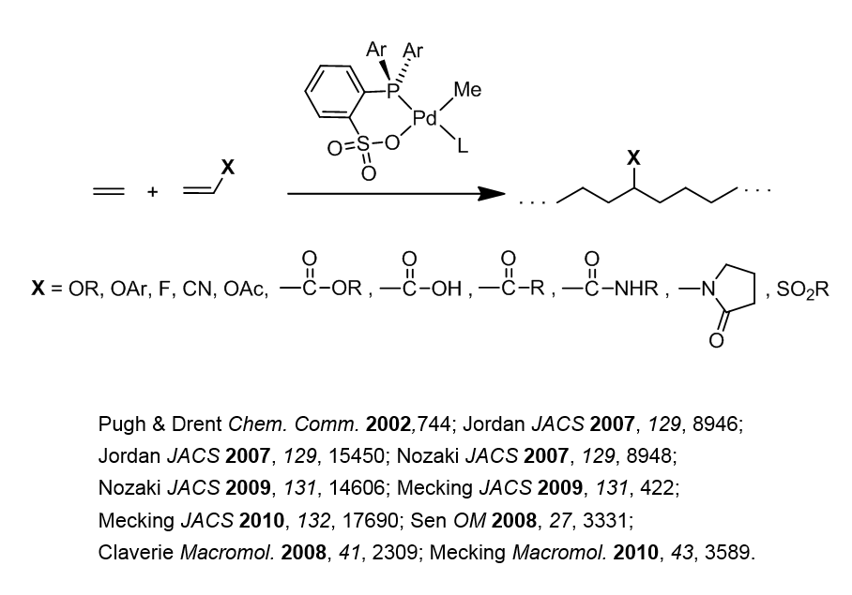

Slide 3
